Slide 1
COMP1003 – Algorithms, Data Structures & Mathematics Session 15 Iteration and Recursion
Thomas Wennekers
University of Plymouth

Slide 2
Main Ideas
Computers process large amounts of data in short time.
Central to this is repetition – the same things are done again and again on different data.
Therefore programming languages provide control structures for looping through data ..
.. and repetitive data-structures, called arrays.
Recursion is a way to define objects, equations, or functions that refer to themselves (cf. EBNF). This can lead to very natural and appealing algorithms for some problems.

Slide 3
Why is this important ?
Repetition is central to most real-world problems, e.g.
processing of records in a data base
images or sound samples in audio-visual applications
text document processing
Iteration, recursion, and arrays belong to the most fundamental programming concepts; all languages provide constructs for them.

Slide 4
Aims and Objectives
To recognise the small number of loop-constructs in most programming languages.
To understand the purpose and use of arrays and some algorithms on arrays (e.g., linear and binary searching).
To introduce recursive algorithms by simple but typical examples.

Slide 5
Outline
Loops
Arrays
Linear search
Iterative Binary search
Recursion
Recursive Binary search
Towers of Hanoi

Slide 6
Use Loops, if you want to do something repetitively

Slide 7
Use the for-loop if you know how often you want to do something
for ( i=0; i<n; i++ )
{
< something to do >
}

Slide 8
Use the while-loop if you don't know how often you have to do something
(but know a stopping condition)
while ( <stopping condition> )
{
< block of statements >
}

Slide 9
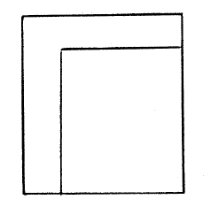
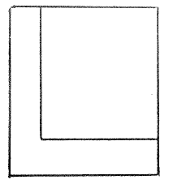
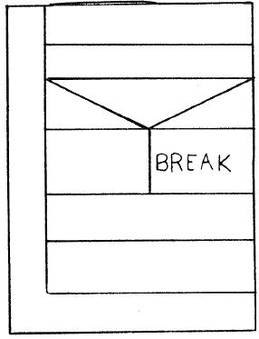
Loops in Structograms
Left: check before block (for-, while-loop; ..)
Middle: check after block (repeat-until; do-while; ..)
Right: break out a loop

Slide 10
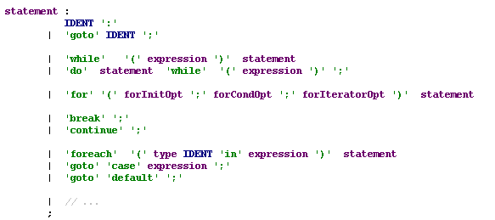
Loops in C# (EBNF forms simplified from MSDN specs)

Slide 11
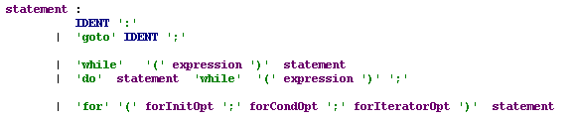
Core Loop Statements

Slide 12
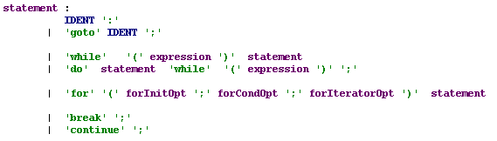
Break and Continue
'break' gets out of the inner loop
'continue' starts the next iteration;

Slide 13
Additional C# Loop Constructs
(Don't use "goto" or "foreach" in COMP1003!)
OOP and Design patterns in Year 2

Slide 14
Arrays store collections of things that can be enumerated in one or more directions
Usually use for-loops to iterate through them

Slide 15
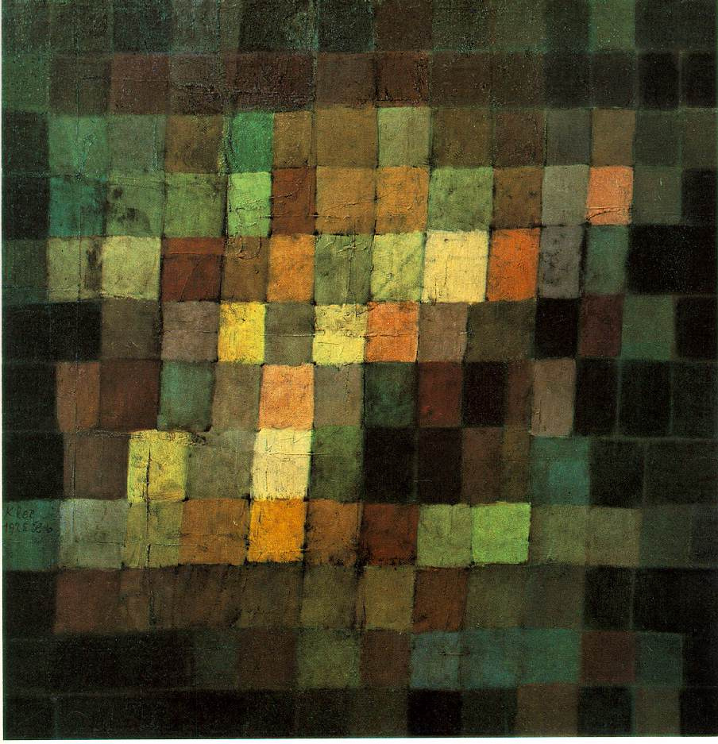
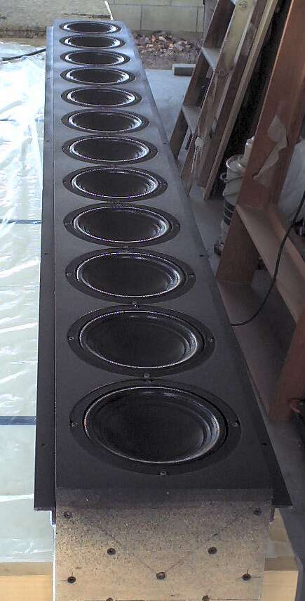
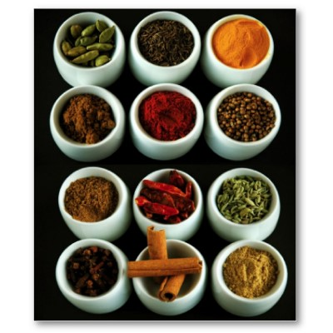
Arrays

Slide 16
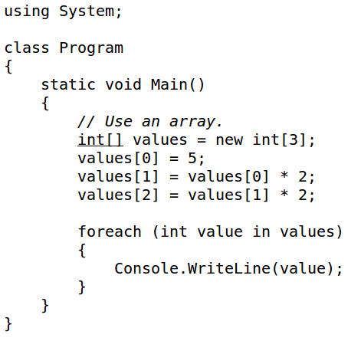
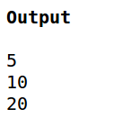
Arrays in C#
One way to get an array of three integers
Dynamic allocation; bracket operator

Slide 17
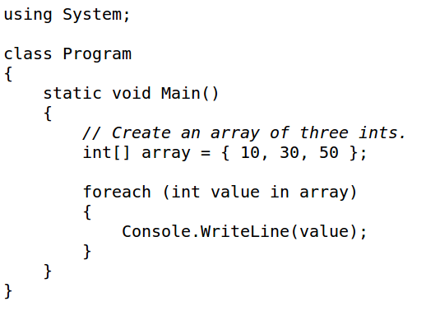
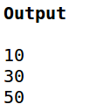
Arrays in C#
Another way to get and initialise an int-array

Slide 18
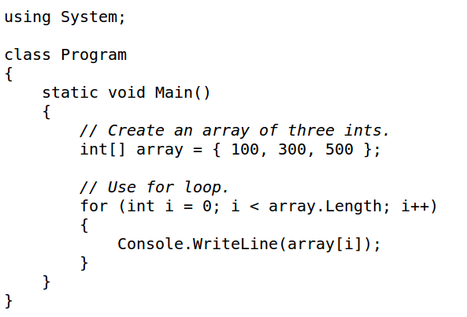

Loop through an array
Use a for-loop if you know the size of the array.

Slide 19
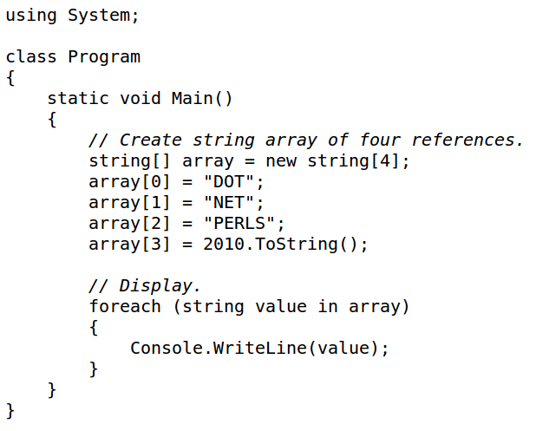

String-Arrays

Slide 20
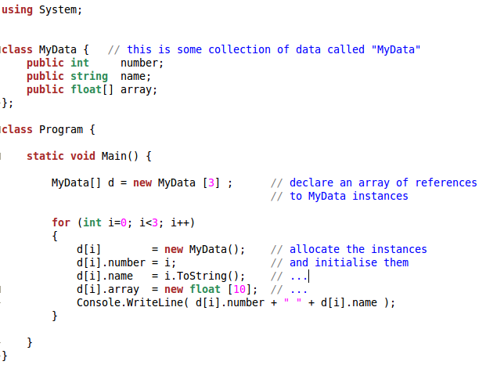
Arrays of Custom Types dot-operator; recursion; space allocation

Slide 21
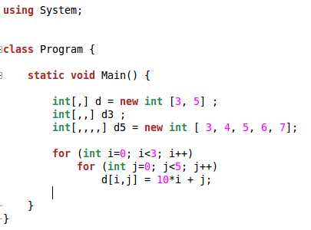
Two- and higher-dimensional arrays

Slide 22
Arrays are used to store data-items of some type
for-loops are used to iterate through arrays
There are numerous useful algorithms on arrays

Slide 23
Linear Search
A common problem:
Given an array see if it contains a certain element
e.g. find a value in an array of integers
e.g. find a student in a data base
Linear search informal solution:
go through the array starting at 0
check each element against the search value
if the value is found, return “true”
(Note: finding all occurrences is another problem)

Slide 24
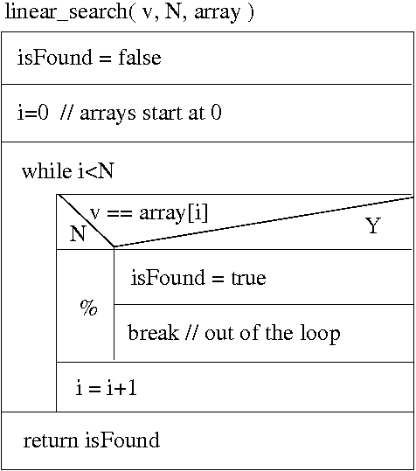
Linear Search
find “v” in “array” of size “N”
“linear search” iterates through the array until the search value is found.

Slide 25
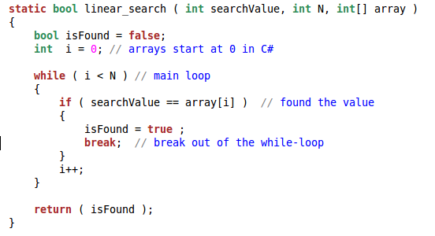
Linear Search
The structogram translates nicely into code; can re-use comments, too

Slide 26
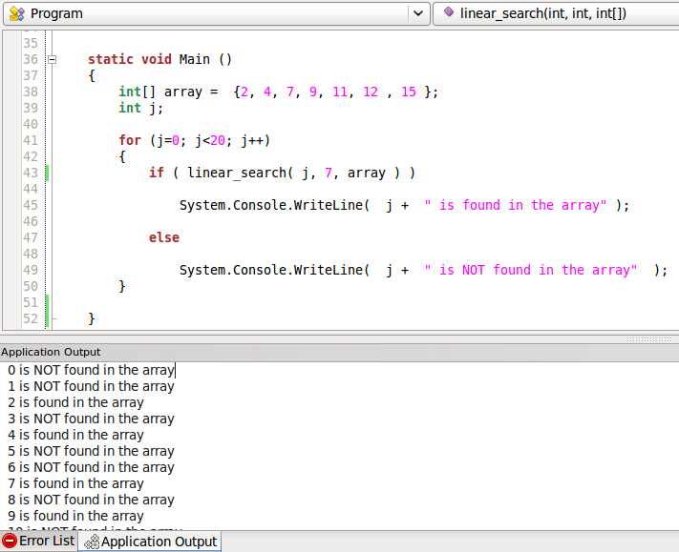
Linear Search Main Routine Example test your code .. Year 2: Unit testing

Slide 27
Binary Search
Linear search needs on average N/2 iterations and N in the worst case.
If we know the array is sorted, we can be quicker!
How to find a word in a dictionary?
Open the dictionary in the middle
If the word is on the page we have found it
If it is “smaller” look at mid-point of the left half
If it is “larger” look at mid-point of the right half
Repeat this “recursively” until the word is found
Note: smaller&larger refers to lexicographic ordering, b>a, etc.

Slide 28
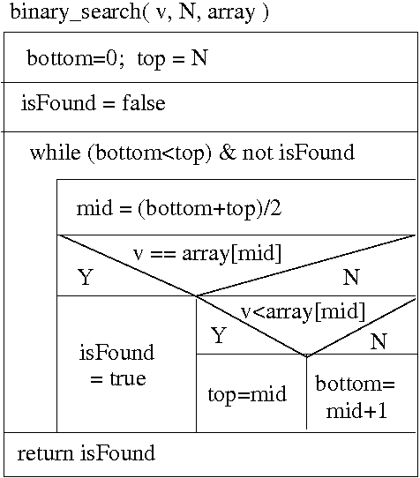
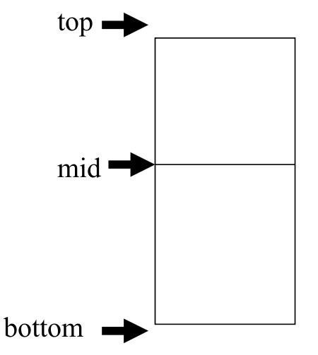
Binary Search

Slide 29
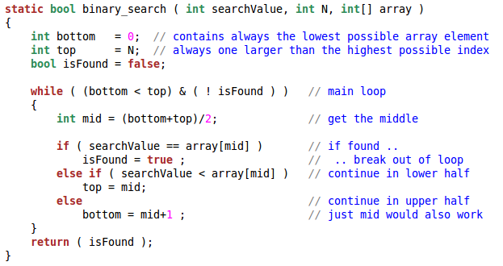
Binary Search in C#
Again the structogram translates directly into code;
You can use structogram text as comments

Slide 30
How fast is binary search?
Linear search eliminates one possibility per iteration; N/2 comparisons on average
Binary search eliminates half of the remaining possible matches in each iteration
4 = 2² elements can be searched in 2 steps
8 = 2³ elements can be searched in 3 steps
.....
2^{M} elements can be searched in just M steps
N = 2^{M} → M = log₂ (N) → lecture “Complexity”

Slide 31
Recursion

Slide 32


Recursion
Definitions of objects, language constructs, functions, equations, or other things are “recursive” if they can refer to themselves.
Example 1) Language definitions

Slide 33
Example 2: Binary Search
Recursive binary search chooses the middle element like the iterative binary search.
If the middle element is the search value the function returns true
If the middle element is bigger than the search value the function calls itself on the left (the smaller) half of the remaining data
Otherwise the function calls itself on the right half
After a number of calls the arrays have size 1 and the recursion terminates

Slide 34
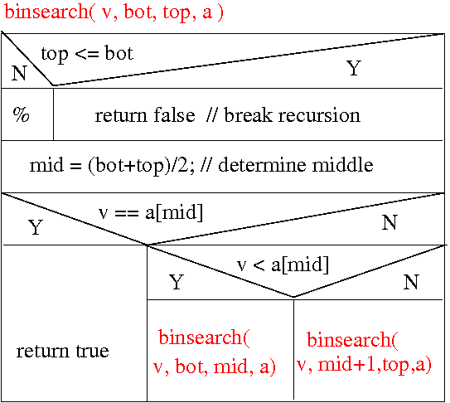
Recursive Binary Search
Note: the algorithm does not have a loop

Slide 35
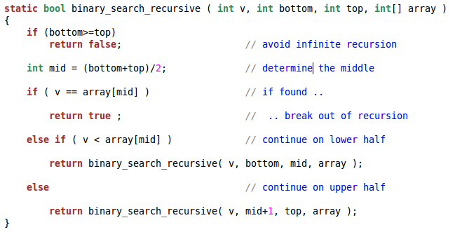
Recursive Binary Search
Call as

Slide 36
The Essence of Recursive Algorithms
Suppose we have some task to carry out on a number N of elements – here is a strategy:
Rearrange the task into smaller sub-tasks
Solve the sub-tasks in the same way, i.e., by dividing them into smaller problems
On some level the tasks become small and easy to solve
Combine the solutions of the sub-tasks into a solution for the bigger tasks

Slide 37
The Essence of Recursive Algorithms
The strategy outlined defines a solution to a task in terms of solutions to the same task, but smaller
When we use recursion in programming, we have a function (procedure/method) whose body contains one or more calls of the same function

Slide 38
Factorial Function
The factorial function of an integer number is the product of all integers up to that number.
factorial( n ) := 1 * 2 * 3 .... (n-1) * n
This can be recursively defined as:
factorial( n ) := 1 if n = 1
factorial( n ) := n * factorial( n-1) if n > 1
→ Worksheet

Slide 39
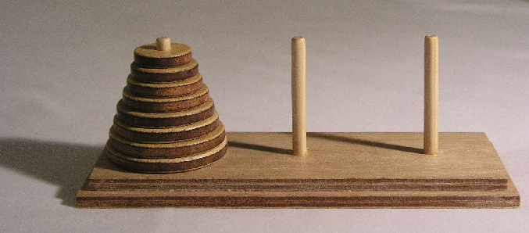
Towers of Hanoi

Slide 40
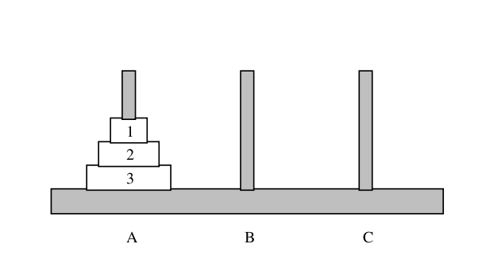
Towers of Hanoi
TASK: Move all disks, one at a time, from peg A to peg B – a disk must never rest on a smaller one.

Slide 41
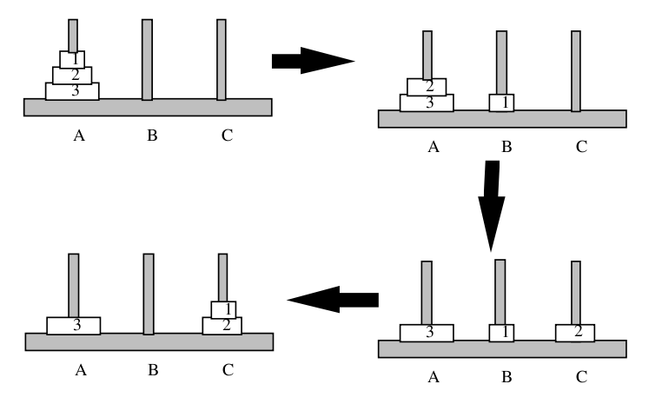
Move a Pile of 2 Disks from A to C

Slide 42
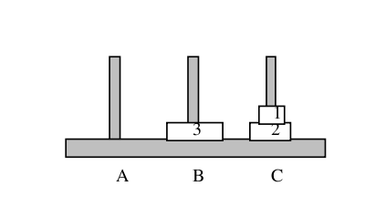
Move the Remaining Disk from A to B

Slide 43
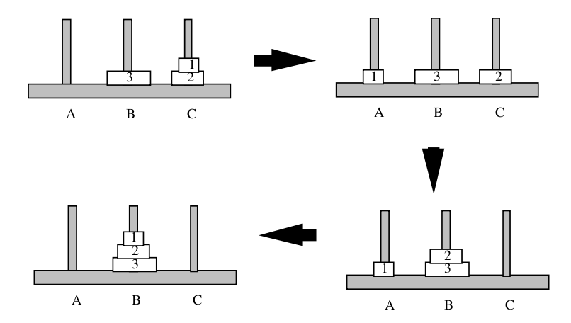
Move a Pile of 2 Disks from C to B

Slide 44
If we can move a pile of 2 disks in 3 moves, we can move a pile of 3 disks in 7 = 3+1+3 moves.
This suggests a recursive solution

Slide 45
Hanoi – Recursive Solution - Informal
If there is only one disk on the fromPeg we just move it to the toPeg
Otherwise:
We clear off N-1 disks onto the spare peg (this is a smaller problem, so we know how to do that)
Now we can move the largest disk to its destination
Now we put the other N-1 disks onto the destination peg (again a smaller problem)

Slide 46
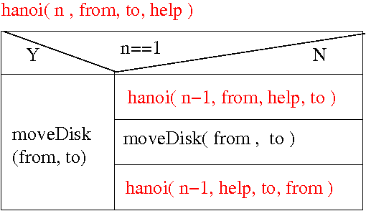
Hanoi – Recursive Solution
Note: “from”, “to”, and “help” must be appropriate data structures to hold the peg contents; “moveDisk()” is a function that updates them when disks move.

Slide 47
Iteration versus Recursion
Each recursive algorithm can be turned into an iterative one and the other way round
For a given problem iterative and recursive solutions exist, and both can have their advantages
The recursive solution may be more obvious to program, or to see how it works
The iterative version may be more efficient in terms of memory space and computing time

Slide 48
Outcomes
Knowledge how to use arrays and loops in C#
Difference between iteration and recursion
Equivalence between iteration and recursion
Examples of search algorithms on arrays
Examples of recursive algorithms

